Slide 1
The Everglades Foundation
LIS4482
Andrew Vargas
Jamel Douglas
Patrick Duke
Alexander Hughes

Slide 2
What is the Everglades Foundation?
NPO dedicated to restoring and preserving the Everglades
Mission: “The Everglades Foundation works to protect and restore America’s Everglades through science, advocacy & education”

Slide 3
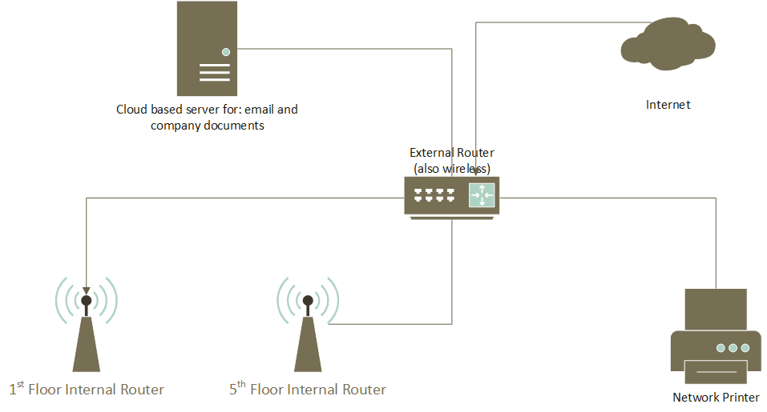

Slide 4
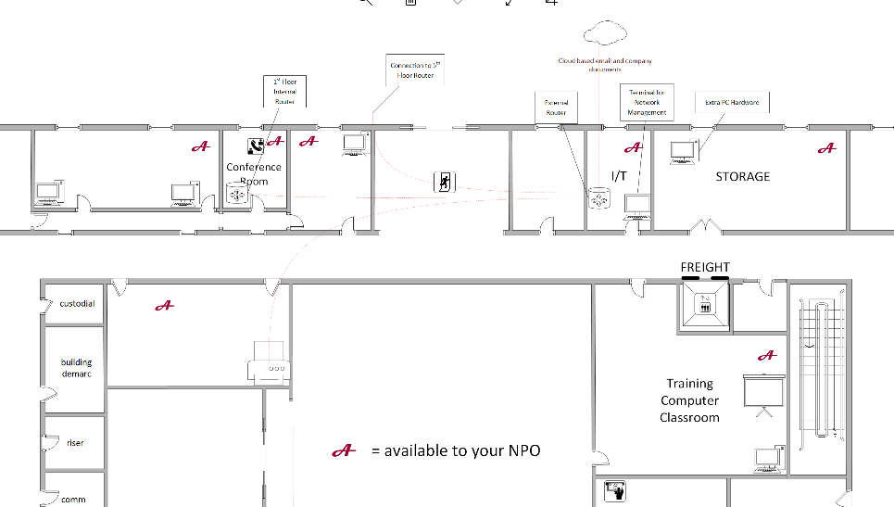

Slide 5
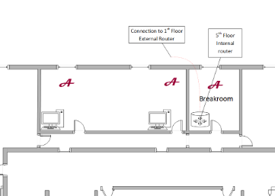

Slide 6
Network Policies
- Local DNS server
- DHCP Server, dynamically assigned IP addresses. The 3 routers will have static IP addresses
- VPN Server for remote access to network resources
- Network Monitoring & Intrusion Protection
- Cloud server maintained through our cloud services contract
- Local network will be maintained by an full-time employee

Slide 7
Security Policies
-Physical Security include security at reception, a deadbolt doors on all limited access rooms such as the IT room, weekly security seminars for best practices that cover system updates, password basics, and safe practices such as email attachments.
-IT room consists of an external router, connected to a terminal, and is the only point of access to the internet.
-We will be using the Synology RT2600ac as our router
-Access to these interface features are only accessible through QuickConnect in the IT room

Slide 8
Disaster Recovery and Fault Tolerance
-Strong Fault Tolerance with spare parts and components
-RAID Solutions (disk mirroring)
-Offsite location for storage and data safekeeping
-Cloud based using IDrive Personal storage with 2 factor authentication
-Back everything to multiple external hard drive kept at an offsite secure undisclosed location

Slide 9
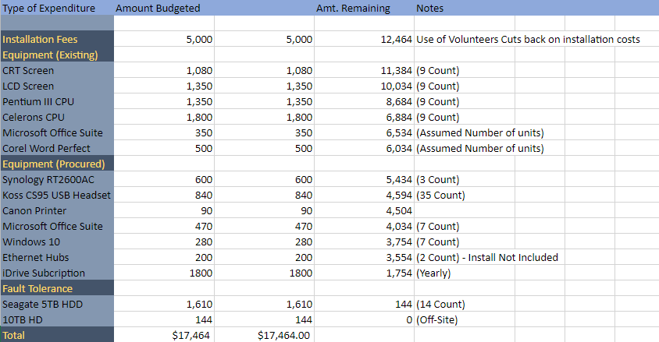
Budget
Amount

Slide 10
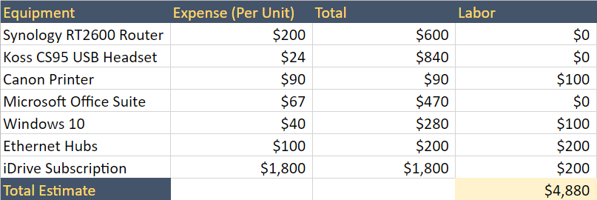
Appendix C: Bill Of Materials
-The RT2600 Routers and CS95 Headsets can be set up by the interns and volunteers since they are easy to use, and install does not take a professional.
-The software (Microsoft Office and Windows 10) would be installed by the Users of the Computers (the 7 Desktops in the various rooms)
-12 Port Ethernet Hubs replaced
-iDrive and Printer installed
-Cat6 Wiring 800 Feet

Slide 11
References
About: The Everglades Foundation: United States. (n.d.). Retrieved November 30, 2020, from https://www.evergladesfoundation.org/about
FAULT TOLERANT POWER SYSTEMS – AN OVERVIEW. (2019, July 16). Retrieved November 30, 2020, from https://technologydynamicsinc.com/information/application-notes/fault-tolerant-power-systems-an-overview/
Glen E. Clarke. CompTIA Network+ Certification Study Guide Fourth Edition Retrieved November 30, 2020, from https://cn3201cs.files.wordpress.com/2015/01/comptia-network-certification-study-guide-fourth-edition.pdf

